Slide 1

Website Programming
□ using cookies □ navigate/relocate □ passing values across pages

Slide 2
Passing variables across pages
JavaScript is an interpretable language
it is executed line by line
it is executed every time you call the file
you can't store variables from one call to another one (calls made from different pages)
all variables are loosing their values when the execution of the file finishes
you could store the values in the global variables as long you use them from the same page

Slide 3
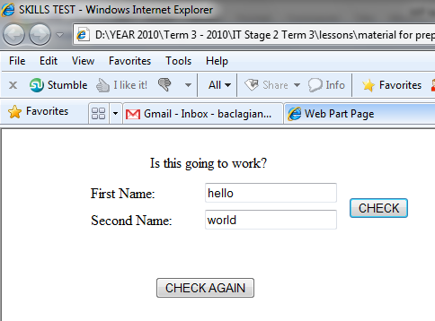
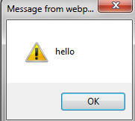
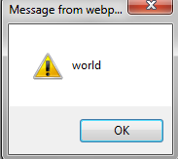
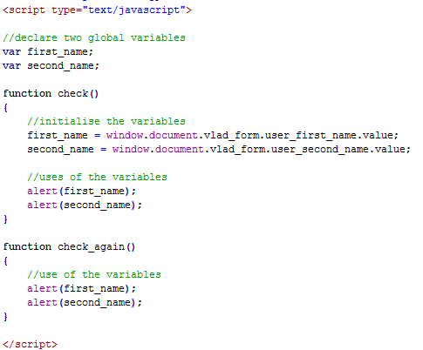
imagine....the same page
button CHECK calls a function that outputs the values from the text boxes
the values are stored in 2 variables that are declared as global
button CHECK AGAIN calls a function that tries to outputs the same values from the text boxes
what is going to be the result?

Slide 4
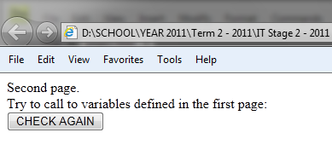
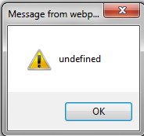
imagine....different pages
button CHECK makes calls FROM PAGE 1
button CHECK AGAIN calls a function that tries to outputs the same values from the text boxes but the button is on a SECOND PAGE (second tab or second window)
what is going to be the result this time?

Slide 5
why it is not working?
for CHECK....
for CHECK AGAIN....
START
START
1
1
2
2
3
3
JS code is read from top (where the global variables are stored) then jump to the function
in the first case the variables contain the values entered by the user
but in the second case they are not defined because they do not have any value assigned to them
every time we call the script, regardless of function, the global variables are considered like they are used for the first time
so WE CAN'T STORE VALUES IN THEM

Slide 6
"submit" versus "button"
find the difference by yourself!

Slide 7
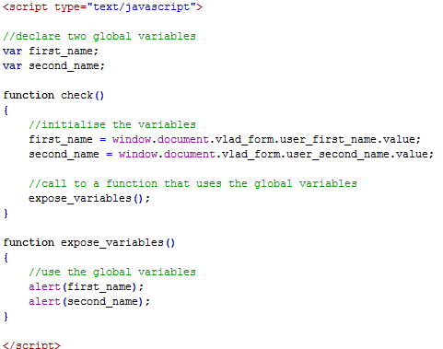
how to use global variables? (the same page)
in this case the call to check() will initialise the global variables
when the expose_variables() is called it will use the global variables

Slide 8
so we can't store values in the script files....hm not good! so how do we pass values from page to page?
the most used methods are:
using the server, but is too complex and there are cases when we do not have a server (like when use a local host)
using the URL address to append the values and then later recover them but it is not safe because the values could be seen by everyone
using cookies, little text files stored on the local machine
Using local storage

Slide 9
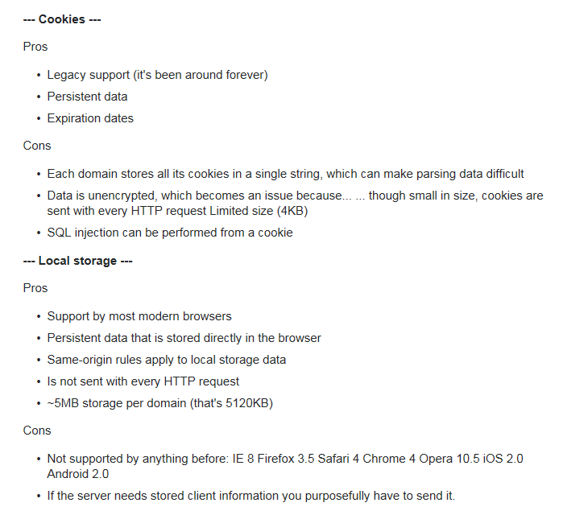

Slide 10
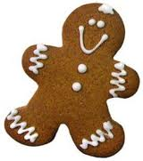
C KIES
cookies are small text files (4KB) that contain details about the user, sessions, etc (data could be encrypted or not)
process:
a website is requested using a browser on a local machine
the request is sent to the server where the site is stored
cookies are created by the website
cookies are stored on the local machine where the request was made
they are sent back to the server every time the user access that site
cookies could be set to expire
cookies are created only if the server application wants to create
if you create cookies from the local machine on the local machine (testing) they are not generated (so do not look for them) they are stored in the document object
More here

Slide 11
how to eat, sorry view cookies!
each browser has different locations for storing cookies
the easiest and most organised way to look at the cookies is to use the browser already built options
for example in IE there is a developer tool:
go to the website you want to check
click F12 or go to 'tools' and then to 'developer tool'
a window will open with all kind of features that could help the HTML development (you can check the HTML code, CSS code or even run JS scripts)

Slide 12
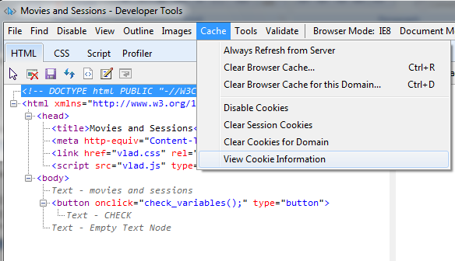
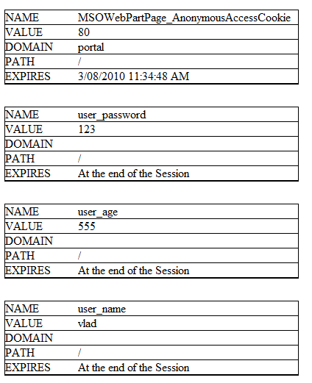
how to view cookies in IE prior to version 11
click 'cache'
click 'view cookie information'
an IE window or tab will open with the details of the address and all the cookies that are associated with this address

Slide 13
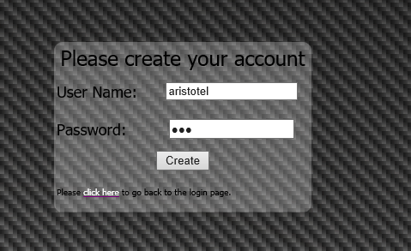

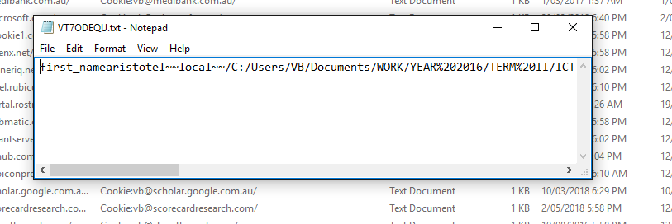
how to view cookies in IE version 11
Tools
Internet Options
General TAB
Browsing History
Settings
View files

Slide 14
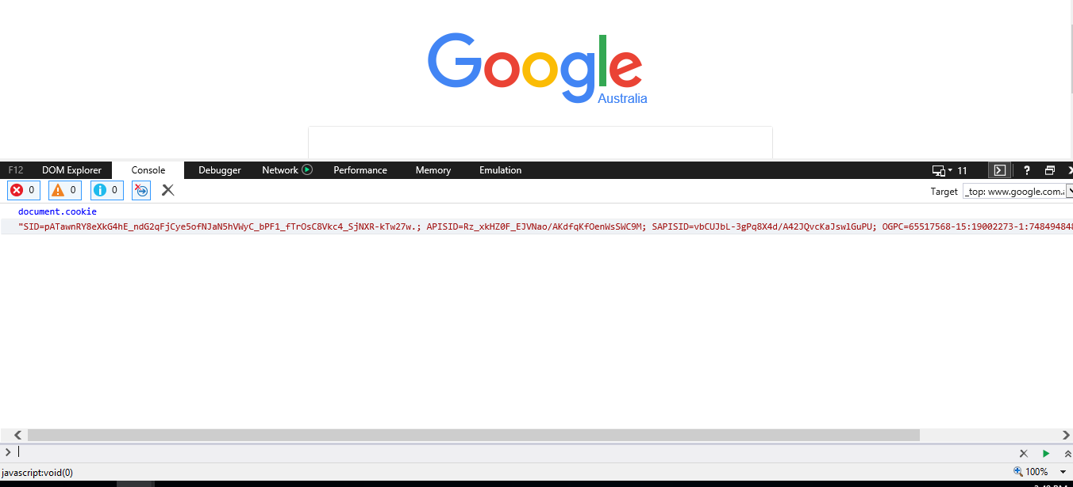
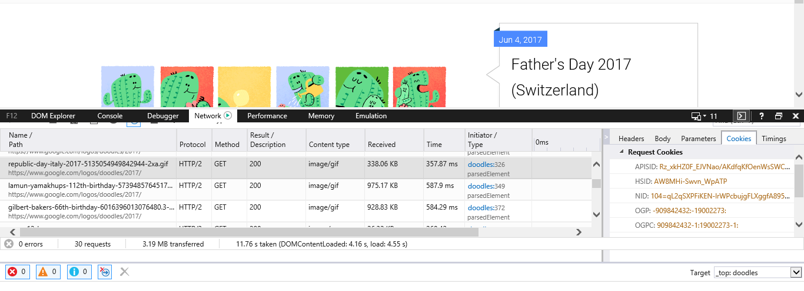
IE 11 via developer tools

Slide 15
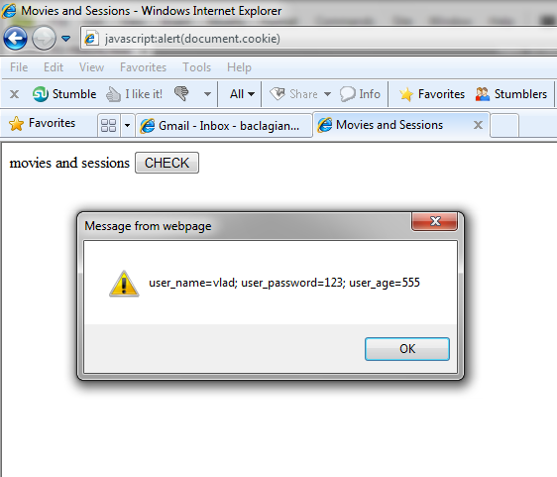
simple way to see cookies but not so detailed:
type in the address bar, of the website you are checking, the following JS code: javascript:alert(document.cookie)

Slide 16
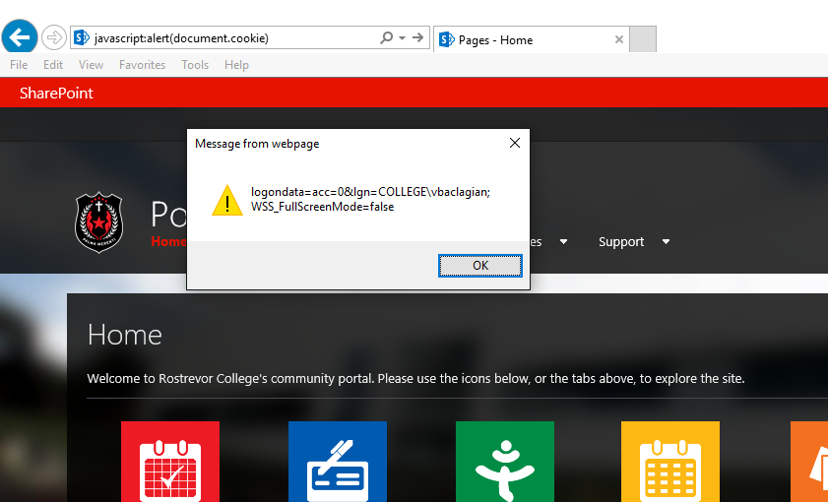
simple way to see cookies but not so detailed:
type in the address bar, of the website you are checking, the following JS code: javascript:alert(document.cookie)

Slide 17
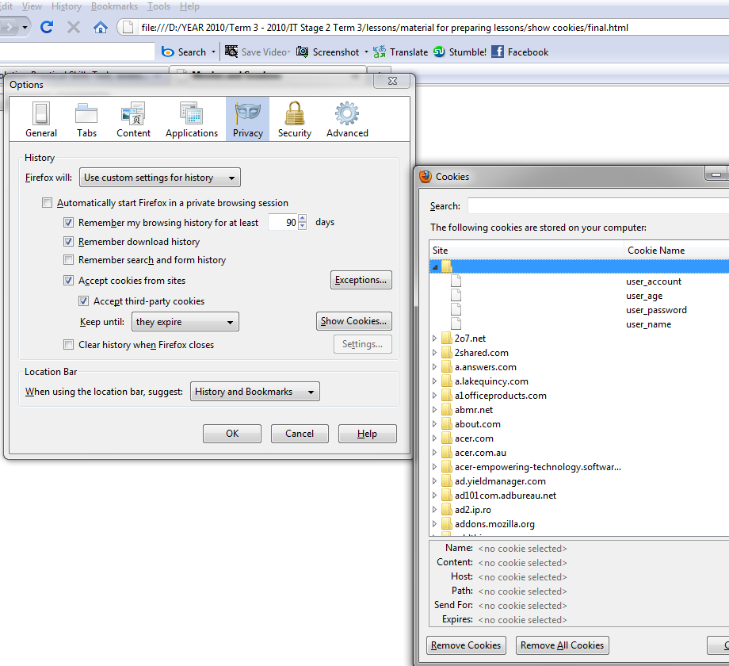
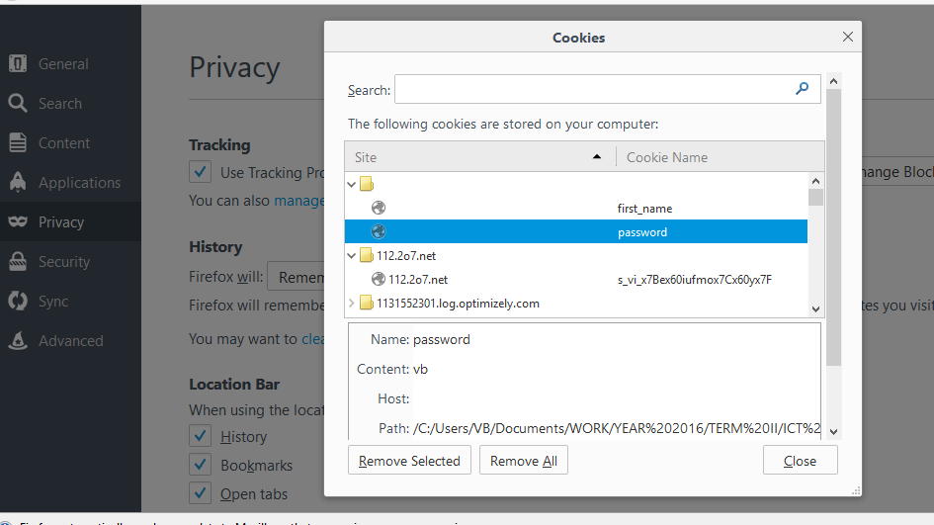
Firefox preview of cookies

Slide 18
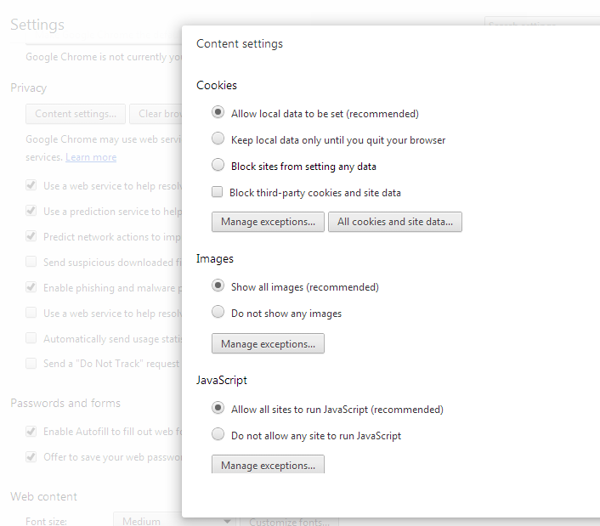
Chrome preview of cookies
Go to settings
Advanced settings
Privacy
Content settings
All cookies and data
Look at the cookies

Slide 19
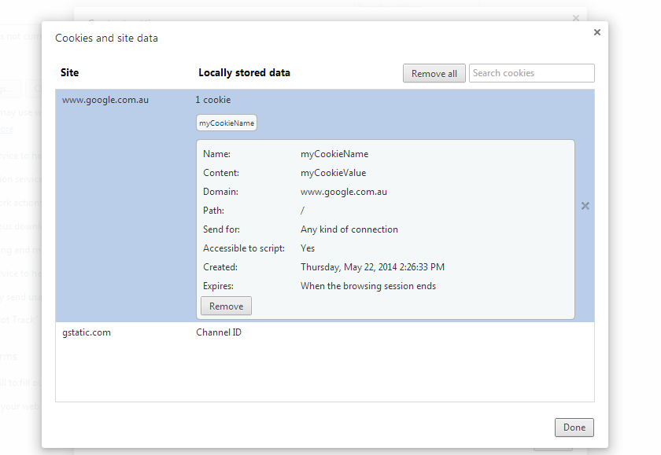

Slide 20
Chrome and COOKIES
Chrome doesn’t let you run cookies on a local machine
It will only save them if you add your files to a server
So we do not test for the moment on Chrome
Opera use to be like this but the community to put pressure to change and now is working

Slide 21
Chrome and COOKIES
For your consideration
Run XAMPP on a USB (Apache server) and put your files in the HTDOCS folder
Then go to : http://127.0.0.1/index_cookies.html
This will make Chrome use and store your cookies

Slide 22
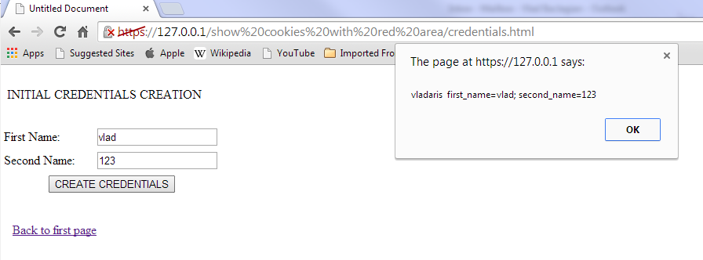
Chrome and COOKIES

Slide 23
Using cookies on a local machine (a simple mechanism to send data to multiple pages)
cookies are created in pairs:
one cookie document.cookie="name1=value1"
another one document.cookie=" name1=value1; name2=value2"
each time we add a cookie it is appended at the end of the cookie file
to extract the cookie you have to search for the name of the cookie and read the value associated with it
cookies could be set with an expire date:
document.cookie="name1=value1; expires=31-December-2010 GMT"
cookies are stored as strings
if you want to delete a cookie set the expire date in the past or set the maximum age (in seconds) to 0:
document.cookie="name1=value1; expires=31-July-2010 GMT"
document.cookie="name1=value1; max-age=0"

Slide 24
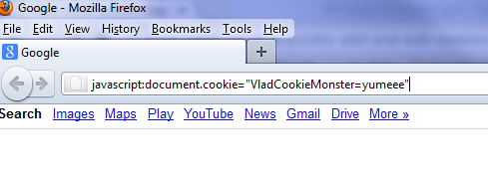
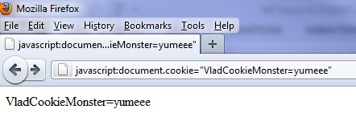
How to create a cookie….just for fun!!! If you copy and paste, JavaScript is disabled for address bar so you have to type

Slide 25
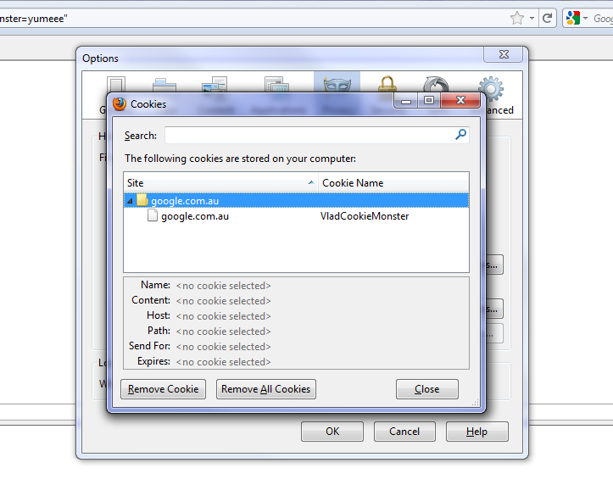

Slide 26
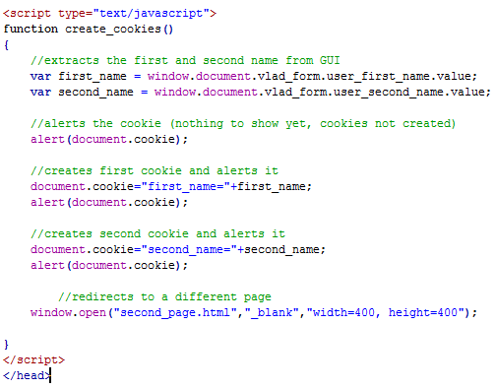
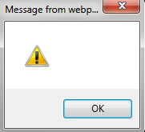
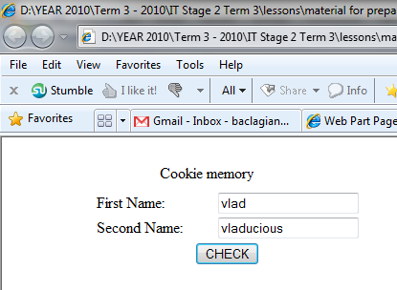
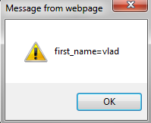
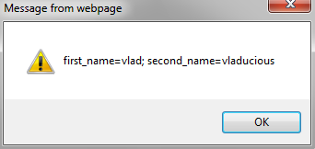
Let's create 2 cookies using code
what will be alert?

Slide 27
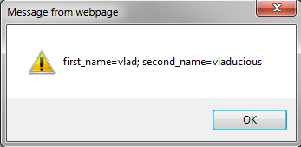
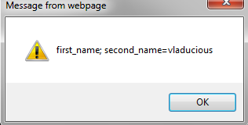
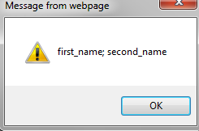
what will be alert when we try to run the file again this time with empty boxes?
remember that JS doesn't remember from call to call so you expect to have undefined....
this time will be different....

Slide 28
even if the file is run again the cookie stored the value
now the first cookie is rewritten with the new value which is empty
now the second cookie is rewritten with the new value which is also empty

Slide 29
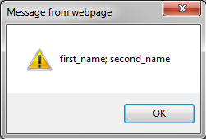
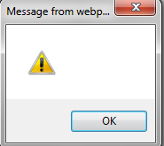
how to delete the cookie
in this simple case the cookie will expire when the session ends
a session ends when the browser is closed ( not when you close the tab )
to make them available between sessions you have to set the expiration day
to delete the cookie just set the expiration date in the past or maximum age to expire to 0 (the second one is more used)
two cookies with values
empty cookies
no cookies
clear and simple tutorial ...here

Slide 30
EXERCISE TO HAVE COOKIES AVAILABLE TO MULTIPLE PAGES

Slide 31
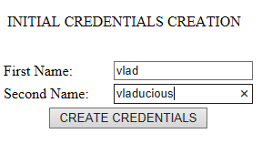
Make it available to other pages (first page where we enter the values for the two cookies)

Slide 32
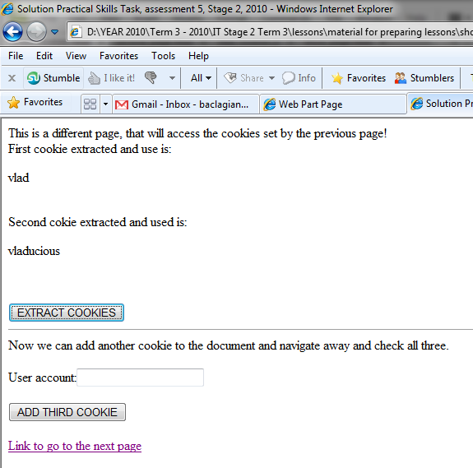
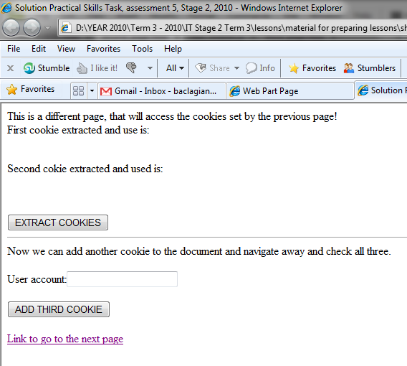
Make it available to other pages (in this case a second page)
extract the values of the cookies when click on the button
Before extraction
After extraction

Slide 33
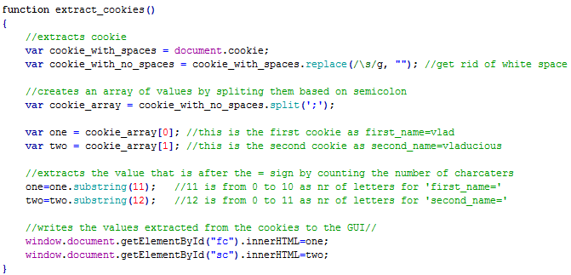
a simple and basic method to extract the cookies from the document
String Object's "replace()" method take two parameter. The first one is what to replace and the second one is what to replace with. In out case the first parameter is made of a REGULAR EXPRESSION. A regular expression is a sequence of characters that creates a pattern to be searched for.

Slide 34
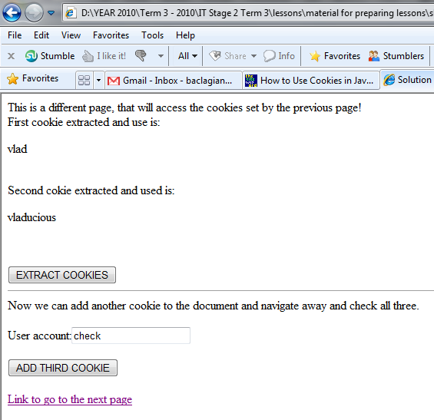
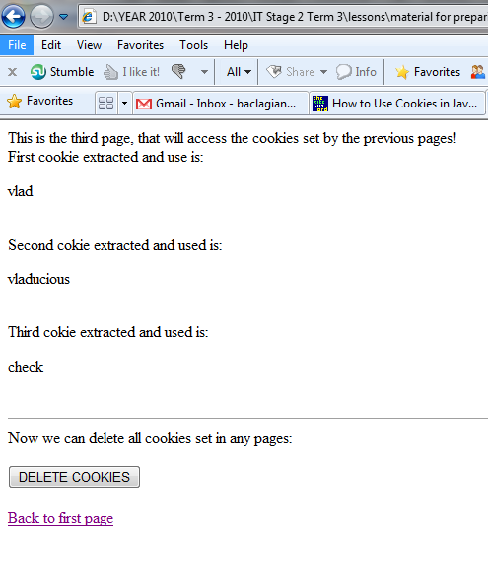
Make it available to other pages (the third page)
add the new value of the cookies when click on the button
the new cookie will be the set: account=check
the name is account and the value is check

Slide 35
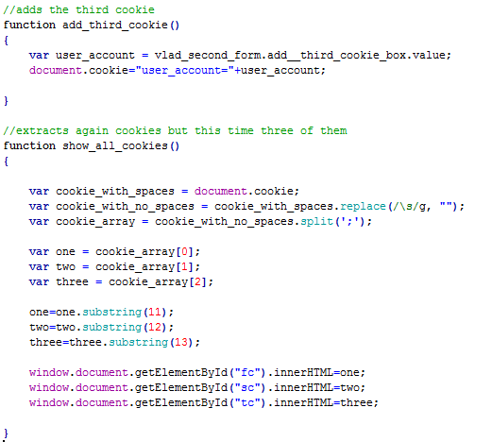
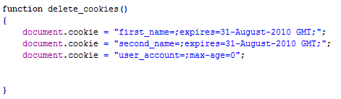
adding another cookie and extracting all of them
deleting all the cookies

Slide 36
USER GUIDE Task 4: Authentication using COOKIES
Problem: in your User Guide create an HTML and JavaScript program that could authenticate a user with user name and password. When the user is wrong a website with an error will be shown. If the user is successful a new page is shown.
On the new page you have to use 3 user input types (drop down boxes, text boxes, radio button or check boxes)
You have to be able to store the user name and the values from these 3 inputs in a cookie document
Then you go to the third page where you output all 4 cookies
You also have to be able to delete these cookies
Follow the next slide's file structure...

Slide 37
file organisation
PAGE 3
PAGE 4
JS file
CSS file
Input type 1:
User name value
Input type 2:
Input type 1 value
PAGE 1
Input type 2 value
Input type 3:
Input type3 value
Authenticate
DELETE
GO
CLOSE
User Name:
YES
Password:
PAGE 2
CHECK
THE RED AREA COULD BE IMPLEMENTED AS PART OF THE AUTHENTICATION PROCESS (USING IF/ELSE STATEMENTS TO CHECK IF THE COOKIES ARE SET)
PAGE 2 AND 3 APPEAR INSTEAD OF THE PARENT PAGE 1 (REPLACING IT)
PAGE 4 IS A POP UP PAGE
ON PAGE 4, CLOSE BUTTON CLOSES THE WINDOW
ON PAGE 3 DELETE BUTTON WILL DELETE THE COOKIES AND RETURNS YOU TO PAGE 1
PAGE 2 HAS A LINK OR BUTTON TO THE AUTHENTICATION PAGE 1
action!
NO
error message for failing the authentication procedure BACK TO LOG IN
Create initial account
CREATE
User Name:
Password:
CREATE

Slide 38
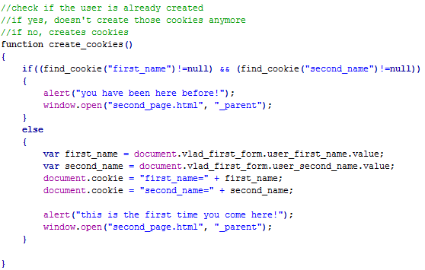
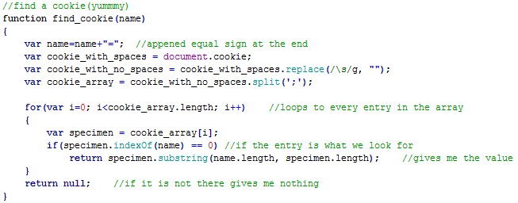
with out red part..... no explanations, you have to find by yourself!!!

